Slide 1
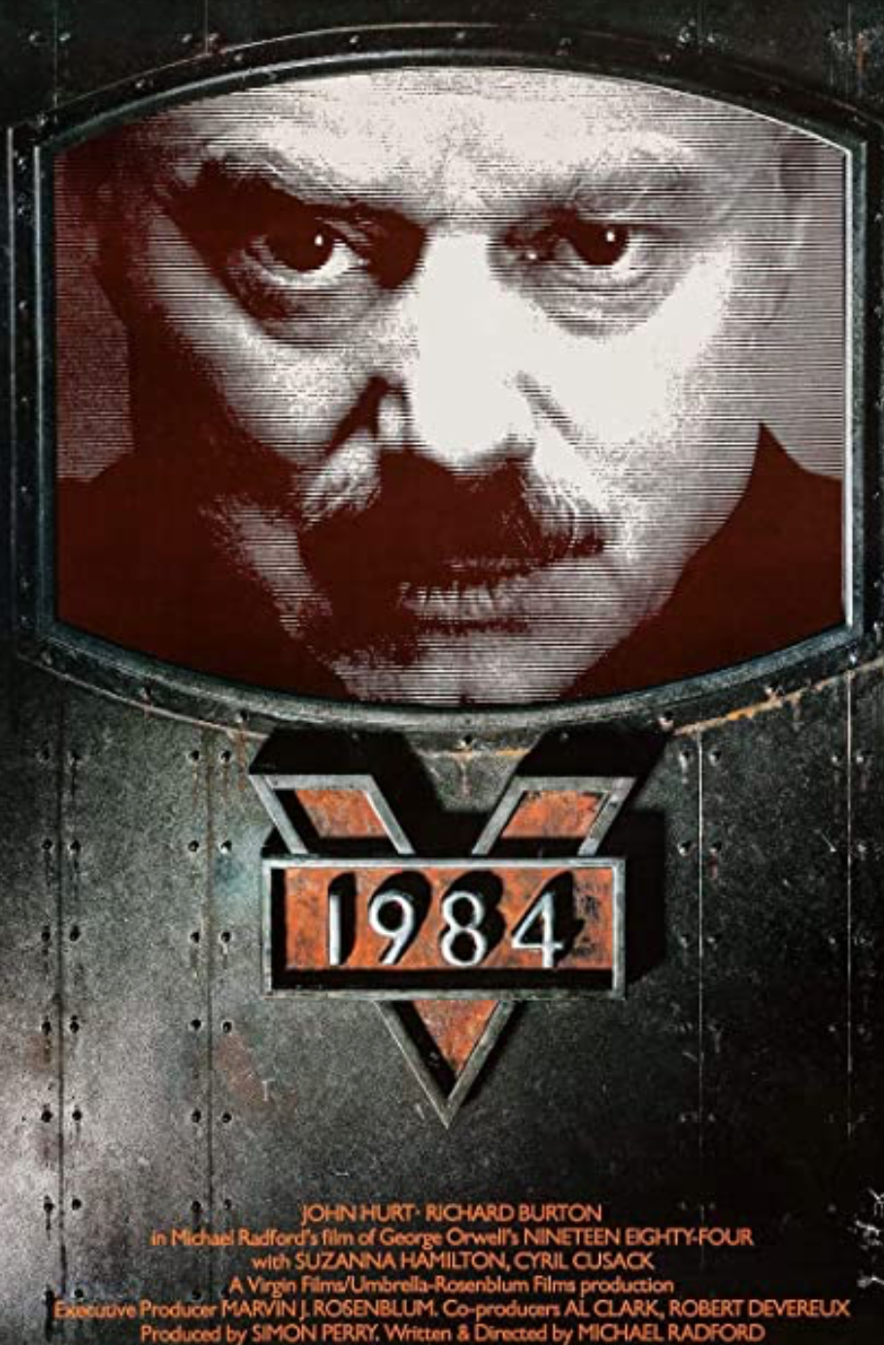

How Many Species of Anti-Democratic Totalitarian Movements?
One, two or three?
Were the Nazis fascists, or were they something else?
A great many people applaud fascism, as creating a solid human community and giving a national community direction and a sense of purpose
Leo Strauss, for example: strongly anti-Nazi from the get-go, but his principles were, “proudly… fascist, authoritarian and imperial…”
Plus fascism as the mortal enemy of socialism, by which, Ludwig von Mises claimed, its: “dictatorships… full of the best intentions… has, for the moment, saved European civilization. The merit that Fascism has thereby won for itself will live on eternally in history…”
Were the really-existing socialists fascists, or were they something else?
Were communists and fascists really the same thing—all focused on the leader and unity, all anti-liberal, merely, as Hitler said, one socializing external institutions, the other socializing human thoughts?
5:30 of audio in this slide; 10:15 in this slide group
Notes:
Have I committed an error in lumping fascists in with Nazis here?
A great many people have applauded fascists, after all. The University of Chicago’s political philosopher Leo Strauss, teacher of some and darling of many on America’s political right, proudly stated that even though the Nazis were misapplying them that his principles remained: “fascist, authoritarian and imperial”. Far-right economists’ darling Ludwig von Mises wrote of fascism that it was: “dictatorships… full of the best intentions… their intervention has, for the moment, saved European civilization. The merit that Fascism has thereby won for itself will live on eternally in history”. (He did immediately thereafter call it an “emergency makeshift” and warn that “view[ing] it as something more would be a fatal error”.
Libertarian darling Friedrich von Hayek urged Margaret Thatcher, in a document that has somehow gone missing, to hew more closely to the methods of Augusto Pinochet in scotching Labour opposition to her policies. (She replied politely that “some of the measures adopted in Chile are quite unacceptable…. We shall achieve our reforms in our own way and in our own time.”)
In seeing them as part of the same species, am I illegitimately tarring their views with those of Adolf Hitler?
Perhaps. Perhaps not.
It is certainly true that if fascists were of the same species, they were much tamer versions of Nazis. Most fascists’ economic doctrine was largely negative: they were not socialists, and they did not believe that the Marxist platform of the nationalization of industry and the expropriation of the capitalist class was the right way to run an economy. But they did not buy into the “national living space”, “lebensraum” doctrines of Hitler. They were less anti-semitic. And they tended to do their killing on a retail rather than a wholesale scale.
But fascists were identifiably of the same ideological genus as Nazis. They recognized each other. It is no accident that Hitler writes of his “profoundist admiration for the great man south of the Alps,” Benito Mussolini, the founder of fascism. It is no accident that Mussolini allied with Hitler during World War II, and no accident that both Hitler and Mussolini sent aid to Francisco Franco's rebels in the Spanish Civil War of the late 1930s. It is no accident that Nazis fleeing Europe after the collapse of Hitler’s Third Reich found a welcome in Juan Peron’s Argentina.
Have I committed an error in not lumping fascists in with really-existing-socialists here? Perhaps. For how much difference was there between the fascist and the really-existing-socialists?
A distressing number of people, starting with Mussolini himself, seem to have transited from one to the other directly. That suggests not a left-right political spectrum but rather a color wheel. Red and blue are as far apart in terms of visual spectrum wavelength as colors can be. Yet if you take magenta paint and add a little bit of cyan you get blue; if you take magenta and add a little bit of yellow to get red. Felipe Fernandez-Armesto put it most eloquently, in the context of George Orwell’s “but aren’t we all socialists?” question he asked in Barcelona in 1937, as he watched the Stalinist socialists exterminate the POUM faction he had joined when he arrived in the city (while Franco's fascists waited outside), comparing it to “aren’t we all Christians?” asked at the sixteenth-century massacre of Protestants in Paris on St. Bartholemew's Day:
>The extremists at both ends seemed close enough to touch.... Individuals moved between fascism and militant socialism as if by connecting channels…. My father... carried a communist card and wore a [fascist] Falangist uniform [in Spain] at different moments in the 1930s…
There were important differences in the way of policy: As Hermann Rauschning claimed Hitler had said to him: “Why need we trouble to socialize banks and factories? We socialize human beings!” The focus on control over institutions and commodity flows as primary and control over what people think, say, and do as secondary in really existing socialism is a difference. But how profound a one?
And while status inequality was important to really existing socialists, material inequality and ruling-class luxury was… embarrassing. By contrast, material inequality and ruling-class luxury were, for fascists, something that demonstrated that you were not with the program if it bothered you.
But do these make up a difference in species, or just variation within a species properly called “totalitarian”?

Slide 2
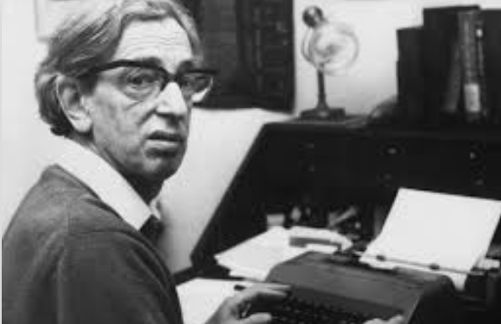
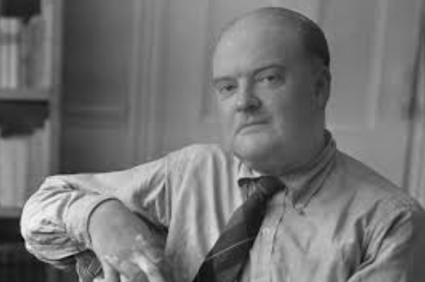
Is There Value in Unity for Unity’s Sake?
British communist historian Eric Hobsbawm
His views:
Only joining a “Moscow aligned Communist party... offered both to interpret the world and to change it, or looked better able to do so.... the only game in town…”
“Lenin’s ‘party of a new type’… gave even small organizations disproportionate effectiveness, because the party could command extraordinary devotion and self-sacrifice…. This impressed even hostile observers profoundly…”
The British Communist Party’s pro-Hitler stance in 1939-41 dictated by Moscow was “something heroic…. Nationalism, political calculation, even common sense, pulled one way, yet they unhesitatingly chose to put the interests of the international movement first…. They were tragically and absurdly wrong. But their error... should not lead us to ridicule the spirit of their action. This is how the socialists of Europe should have acted... carrying out the decisions of the International.... It was not their fault that the International should have told them to do something else…”
These are all, quite frankly, fascist.
4:45 of audio in this slide
Notes:
The British communist historian Eric Hobsbawm—a card-carrying communist from before World War II until 1956—has a couple of asides in his histories that strike me as revealing. The first comes in his history of the short twentieth century, the Age of Extremes: Only joining a:
>Moscow aligned Communist party... offered both to interpret the world and to change it, or looked better able to do so.... It was, for most of the world’s believers in the need for global revolution, the only game in town…. Lenin’s ‘party of a new type’… gave even small organizations disproportionate effectiveness, because the party could command extraordinary devotion and self-sacrifice from its members, more than military discipline and cohesiveness, and a total concentration on carrying out party decisions at all costs. This impressed even hostile observers profoundly…
The assumption that unthinking obedience to whoever the current dictator in Moscow was appropriate because it was the way to change the world begs the question of what kind of change, and what kind of world. To take being the follower of a leader whose commands you do not question as a great and good thing—Mussolini and Hitler would have definitely approved; Karl Marx would definitely have not approved.
Thus this is not even a hair’s breadth away from a fascist worship of force and the leader.
And did the party discipline of the really-existing socialists impress or horrify observers?
The impression is that for Hobsbawm (as well as for many others) a principal attraction of communism was in its closeness to fascism: the glorification of force and effectiveness. When World War II broke out, Stalin and Hitler were allied—and world communist doctrine was that the British and French were the bad guys in trying to stop Hitler's expansion. Yet Hobsbawm sees this as:
>something heroic…. Nationalism, political calculation, even common sense, pulled one way, yet they unhesitatingly chose to put the interests of the international movement first…. They were tragically and absurdly wrong. But their error... should not lead us to ridicule the spirit of their action. This is how the socialists of Europe should have acted... carrying out the decisions of the International.... It was not their fault that the International should have told them to do something else…
But if was not Hobsbawm and his fellow cadres’ fault that the International was the puppet of a paranoid dictator in Moscow rather than the pathfinder of humanity’s progress toward utopia, whose fault could it have been?
In my view, Hobsbawm was well answered more than fifty years before he wrote by the American literary critic Edmund Wilson.
Wilson wrote of the:
>remarkable scene at the first congress of the Soviet dictatorship after the success of the October insurrection of 1917, when [Leon] Trotsky, with the contempt and indignation of a prophet, read [the socialist] Martov and his followers out of the meeting. “You are pitiful isolated individuals,” he cried at this height of the Bolshevik triumph. “You are bankrupt; your role is played out. Go where you belong from now on—in the garbage-pile of history!”
>These words are worth pondering for the light they throw on the course of Marxist policy and thought.
>Observe that the merging of yourself with the onrush of the current of history is to save you from the ignoble fate of being a “pitiful isolated individual”; and that the failure to so merge yourself will relegate you to the garbage-pile of history, where you can presumably be of no more use….
>We may agree with the Bolsheviks that Martov was no man of action, [but] his croakings over the course that they had adopted seem to us full of far-sighted intelligence…. Proclaiming a socialist regime in conditions different from those contemplated by Marx would not realize the results that Marx expected; that Marx and Engels had usually described the “dictatorship of the proletariat” as having the form, for the new dominant class, of a democratic republic… that… “All power to the Soviets” had… soon been exchanged by Lenin for “All power to the Bolshevik Party.”
>There sometimes turn out to be valuable objects cast away in the garbage pile of history…. From the point of view of the Stalinist Soviet Union, that is where [Leon] Trotsky himself is today [in the late 1930s]. He might well discard his earlier assumption that an isolated individual must needs be “pitiful” for the conviction of Dr. Stockman in Ibsen’s [play] An Enemy of the People that “the strongest man is he who stands most alone.”

